Slide 1

CERTIFICATE III IN AUTOMOTIVE REPAIR & MAINTENANCE
SUBJECT: VEHICLE MAINTENACE AND REPAIR
By Ibrahim siraj
Maldives polytechnic

Slide 2
VEHICLE MAINTENACE AND REPAIR
Chapter 13 Inspection and Service auto electric system service
What is car Electric system
A car's electrical system is a complex network of components that generates, stores, and distributes electricity to power the vehicle's functions, from the engine starting to interior electronics like the radio and power windows.
three core parts are the battery, alternator, and starter, which work together to start the engine, keep it running, and charge the battery. A modern system also includes extensive wiring, control modules, and fuses to manage all the vehicle's electrical needs.
By Ibrahim siraj
Maldives polytechnic

Slide 3
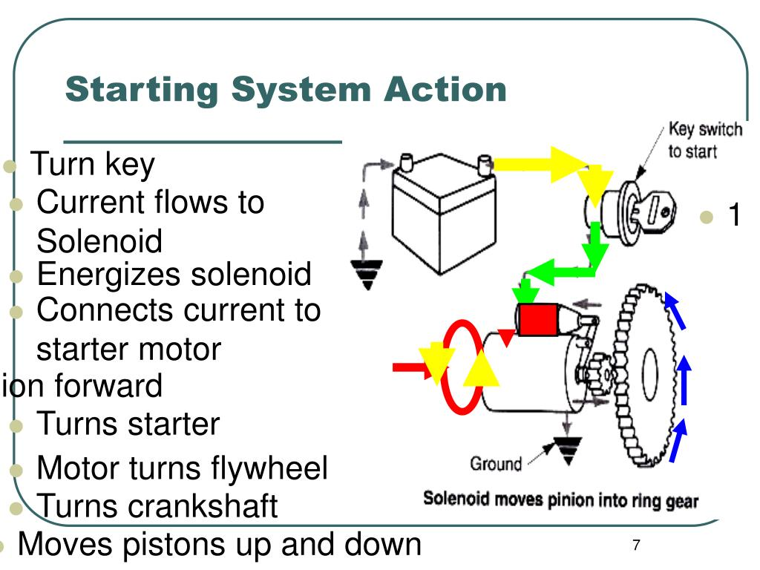
VEHICLE MAINTENACE AND REPAIR
Chapter 13 Inspection and Service auto electric system service
What is car Electric system
By Ibrahim siraj
Maldives polytechnic

Slide 4
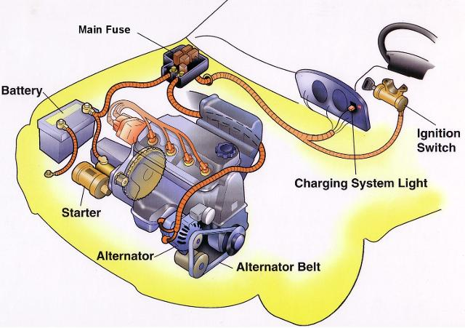
VEHICLE MAINTENACE AND REPAIR
Chapter 13 Inspection and Service auto electric system service
Automotive Starting System Fundamentals
Purpose of the Starting System
Core Function: Converts stored chemical energy into mechanical cranking power.
Cranking RPM: Must spin the engine at 200–300 RPM to start the combustion cycle.
Energy Transfer: Draws massive current from the battery to power a high-torque electric motor
By Ibrahim siraj
Maldives polytechnic

Slide 5
VEHICLE MAINTENACE AND REPAIR
Chapter 13 Inspection and Service auto electric system service
Automotive Starting System Fundamentals
Common battery faults, particularly in vehicles, include corroded terminals (17%), frequent battery drain/discharging (15%), and internal damage/shorted cells often caused by heat or age. Other common issues are sulfation from long-term low-charge states, broken internal connections, and swollen cases from overcharging. These result in poor performance, slow starting, or complete failure.
Key Components Overview
Battery: Supplies the high-amperage current needed for cranking.
Ignition Switch: The gateway control that triggers the starting circuit.
Starter Solenoid: An electromagnetic switch that engages the motor and gear.
Starter Motor: A powerful DC motor that physically cranks the engine.
Flywheel Ring Gear: The large gear on the engine that the starter meshes with
By Ibrahim siraj
Maldives polytechnic

Slide 6
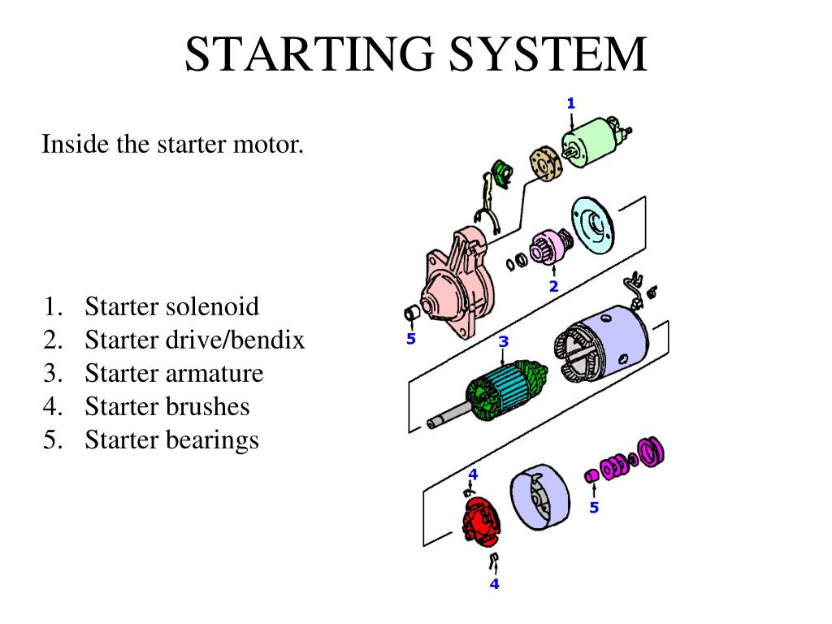
VEHICLE MAINTENACE AND REPAIR
Chapter 13 Inspection and Service auto electric system service
Automotive Starting System Fundamentals
The Starter Motor in Detail
DC Motor Operation: Uses Fleming's Left-Hand Rule to generate high rotational torque.
Armature: The spinning component that creates the rotational force.
Commutator & Brushes: Delivers electrical current to the rotating armature.
Field Windings/Permanent Magnets: Creates the strong magnetic field required for motor operation
By Ibrahim siraj
Maldives polytechnic

Slide 7
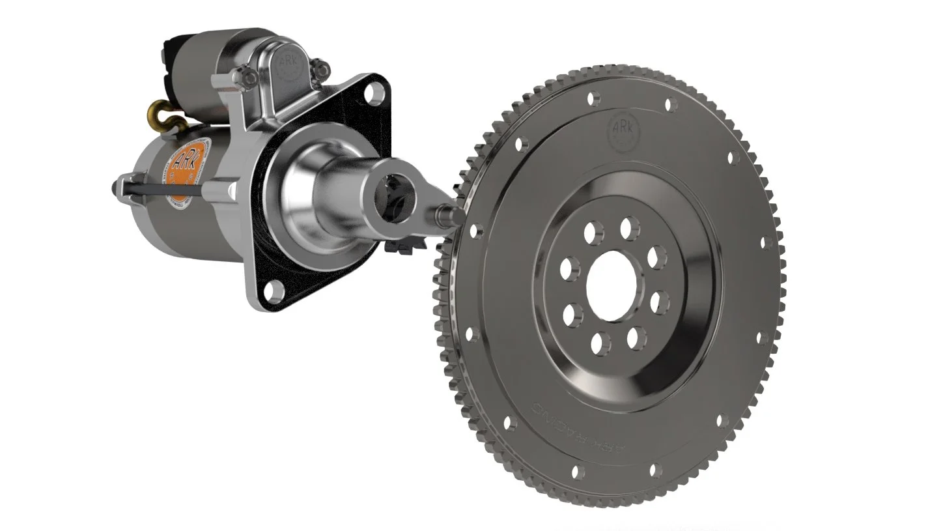
VEHICLE MAINTENACE AND REPAIR
Chapter 13 Inspection and Service auto electric system service
Automotive Starting System Fundamentals
The Drive Mechanism (Bendix Drive)
Gear Reduction: Provides massive torque multiplication (typically 15:1 to 20:1).
Pinion Gear: Small gear on the starter that meshes with the flywheel.
Overrunning Clutch: Freewheels when the engine starts so the engine doesn’t spin the starter to destruction
By Ibrahim siraj
Maldives polytechnic

Slide 8
VEHICLE MAINTENACE AND REPAIR
Chapter 13 Inspection and Service auto electric system service
Automotive Starting System Fundamentals
Step-by-Step System Operation
Driver turns the key to "Start" or pushes the start button.
Control circuit sends low current to the starter solenoid.
Solenoid pushes the starter pinion gear into the flywheel ring gear.
Solenoid closes heavy contacts, sending high current to the starter motor.
Starter cranks the engine until it fires and runs on its own.
Driver releases the key; the return spring disengages the pinion gear.
By Ibrahim siraj
Maldives polytechnic

Slide 9
VEHICLE MAINTENACE AND REPAIR
Chapter 13 Inspection and Service auto electric system service
Automotive Starting System Fundamentals
Safety Neutral & Clutch Switches
Purpose: Prevents the car from starting while in gear to avoid accidents.
Automatic Transmission: Utilizes a Neutral Safety Switch (only starts in Park or Neutral).
Manual Transmission: Utilizes a Clutch Pedal Position Switch (must depress clutch to start)
By Ibrahim siraj
Maldives polytechnic

Slide 10
VEHICLE MAINTENACE AND REPAIR
Chapter 13 Inspection and Service auto electric system service
Automotive Starting System Fundamentals
Common Failures & Diagnostics
Clicking Noise: Usually indicates a dead battery or loose/corroded terminals.
Single Loud Click: Often a bad starter solenoid or jammed starter motor.
Whirring Noise (No Crank): The starter is spinning, but the drive gear is not engaging the flywheel.
No Sound at All: Blown fuse, bad ignition switch, or neutral safety switch failure.
By Ibrahim siraj
Maldives polytechnic

Slide 11
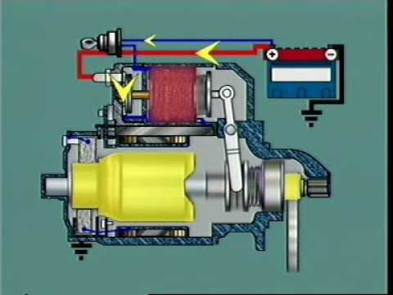
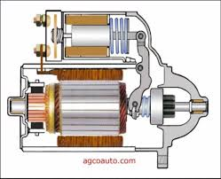
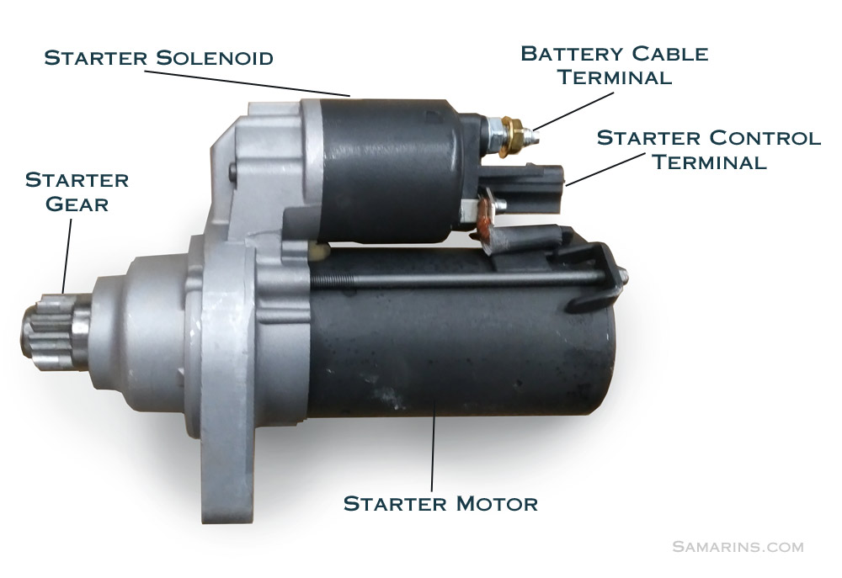
VEHICLE MAINTENACE AND REPAIR
Chapter 13 Inspection and Service auto electric system service
Automotive Starting System Fundamentals
The Starter Solenoid (The Switch)
Dual Purpose: Acts as a high-current relay and a mechanical actuator.
Pull-In Winding: Pulls the plunger to engage the starter drive gear.
Hold-In Winding: Holds the plunger in place with less current once engaged.
Electrical Contact: Bridges the thick battery cable directly to the starter motor
By Ibrahim siraj
Maldives polytechnic

Slide 12
VEHICLE MAINTENACE AND REPAIR
Chapter 13 Inspection and Service auto electric system service
What is car Electric system
Component | Function
Battery | The primary energy source, storing chemical energy and supplying electrical current to start the engine and power components when the engine is off. Most use a 12-volt DC system.
Alternator | Once the engine is running, the alternator converts mechanical energy into electrical energy (AC, then rectified to DC) to power the car's systems and recharge the battery.
Starter Motor | A powerful electric motor that uses battery power to rotate the engine's flywheel, initiating the combustion process.
Wiring & Connectors | A network of cables and terminals that act as the vehicle's "nervous system," transmitting power and signals throughout the car.
Fuses & Relays | Safety devices that protect circuits from overloads (fuses) and use low-power signals to control high-power devices like headlights and the horn (relays).
Electronic Control Units (ECUs) | Miniature computers that manage and regulate the power distribution and operation of various subsystems, from optimizing fuel efficiency to managing advanced driver assistance systems (ADAS
By Ibrahim siraj
Maldives polytechnic

Slide 13
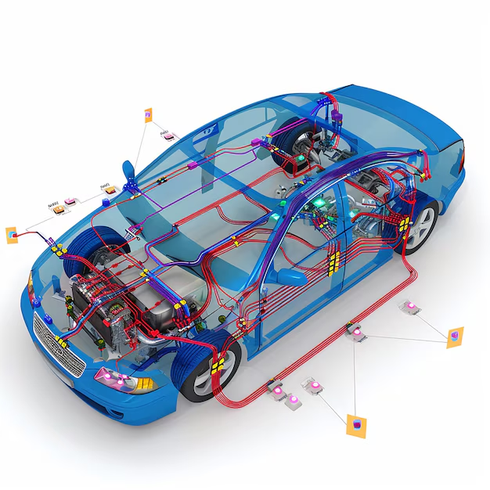
VEHICLE MAINTENACE AND REPAIR
Chapter 13 Inspection and Service auto electric system service
What is car Electric system
By Ibrahim siraj
Maldives polytechnic

Slide 14
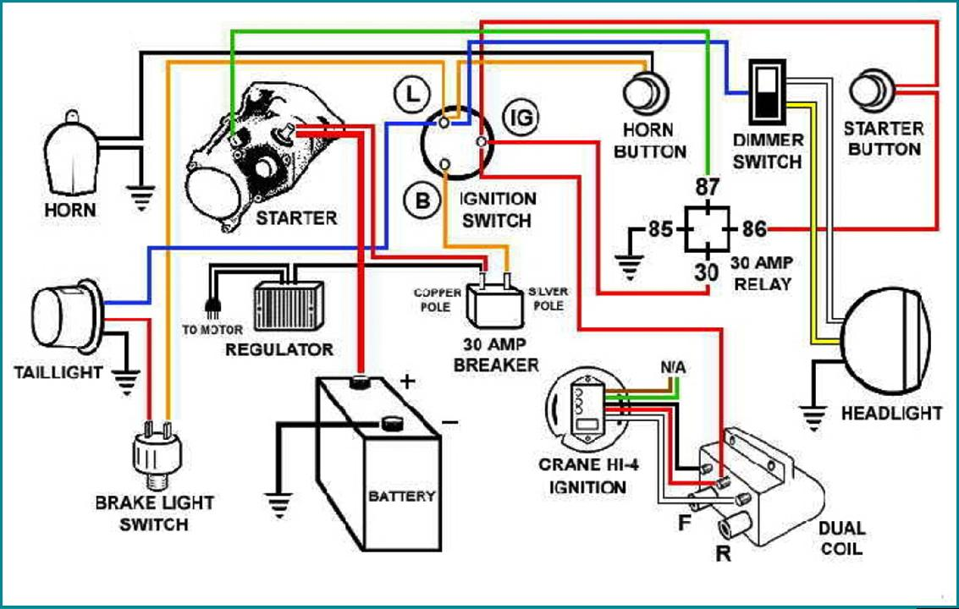
VEHICLE MAINTENACE AND REPAIR
Chapter 13 Inspection and Service auto electric system service
What is car Electric system
By Ibrahim siraj
Maldives polytechnic

Slide 15
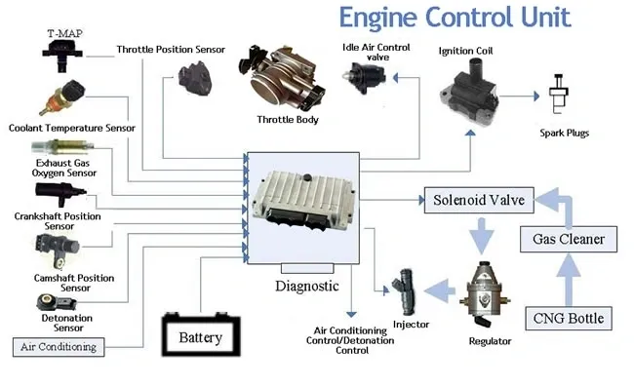
VEHICLE MAINTENACE AND REPAIR
Chapter 13 Inspection and Service auto electric system service
What is car Electric system
The term ECU in a car commonly refers to the Engine Control Unit (or Engine Control Module, ECM), which acts as the "brain" of the engine's management system. It is a small, powerful computer that uses data from various sensors to monitor and regulate critical engine functions in real-time.
By Ibrahim siraj
Maldives polytechnic

Slide 16
VEHICLE MAINTENACE AND REPAIR
Chapter 13 Inspection and Service auto electric system service
What is car Electric system
When turning the key (or pushing the start button) to ON in a Mazda Demio Skyactiv, most dashboard lights illuminate briefly for a "bulb check" and should turn off after a few seconds.
[Red] Check Engine Light: Stays on until the engine starts
[Red] Battery/Charging System: Indicates the electrical system is active.
[Red] Oil Pressure/Level Light: Signals check oil system.
[Red] Air Bag/Seat Belt Pre tensioner: Indicates system check.
[Red] Brake System/Parking Brake: Lights up, especially if the handbrake is on.
[Yellow] ABS (Anti-lock Brake System): Lights up for self-test.
[Yellow] TCS/DSC (Traction Control System): A car icon with swerving lines.
[Yellow] Tire Pressure Monitoring (TPMS): Tire with an exclamation mark.
[Red/Yellow] Key Indicator Light: Displays the status of the key fob and security system.
Important Notes:
If red lights remain on after starting, there is a potential issue.
If yellow lights remain on, it suggests an immediate check of a system is needed.
A "Wrench" indicator may appear if maintenance is due.
By Ibrahim siraj
Maldives polytechnic

Slide 17
VEHICLE MAINTENACE AND REPAIR
Chapter 13 Inspection and Service auto electric system service
Key Starting System Features
An engine immobilizer is an electronic anti-theft security system that prevents a vehicle's engine from starting unless the correct transponder key or smart key fob is present. It works by disabling the fuel system, ignition, or starter motor when it fails to recognize a unique code from the key, making "hot-wiring" nearly impossible
Push-Button Start: A keyless entry system is standard, allowing the engine to start by pressing a button while holding the brake pedal (automatic) or clutch pedal (manual)
.i-stop System: This system automatically shuts down the engine when the car comes to a stop to conserve fuel and restarts it instantly when the brake pedal is released.
Keyless Entry/Operation: The system works when the key is within operational range (inside the vehicle).
Safety Features: If the engine does not start, it may be due to the steering wheel being locked or the smart key battery being dead (you can press the button with the key itself to start in this case).
By Ibrahim siraj
Maldives polytechnic

Slide 18
VEHICLE MAINTENACE AND REPAIR
Chapter 13 Inspection and Service auto electric system service
Core Functions Activated in the "ON" Position
Instrument Cluster and Dashboard: All warning lights illuminate briefly as a bulb check, and digital displays or gauges activate to show fuel levels and system status.
Fuel Delivery System: The electric fuel pump primes for a few seconds to pressurize the fuel lines for starting.
Engine Management: The Engine Control Unit (ECU) powers up, runs self-diagnostics, and begins reading data from sensors like engine temperature.
Ignition System: Power is supplied to the ignition coils (or glow plugs in diesels), preparing them to generate spark or heat.
Climate Control: The blower motor and climate control interface become fully operational, though the air conditioning will not blow cold air since the belt-driven compressor requires a running engine.
Safety Systems: Supplemental Restraint Systems (SRS) like airbags and Anti-lock Braking Systems (ABS) perform self-checks.
Cabin Electronics: Power windows, windshield wipers, 12V power outlets, and full infotainment systems become usable.
By Ibrahim siraj
Maldives polytechnic

Slide 19
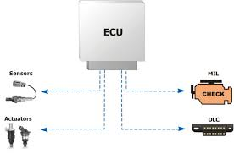
VEHICLE MAINTENACE AND REPAIR
Chapter 13 Inspection and Service auto electric system service
Introduction to On-Board Diagnostics (OBD)
An OBD (On-Board Diagnostics) system is a computer inside your vehicle that monitors the engine, transmission, and emissions systems. When the computer detects a malfunction, it turns on your "Check Engine" light and stores a digital trouble code.
Definition: "On-Board Diagnostics" refers to a vehicle's self-diagnostic and reporting capability.
Purpose: It gives the vehicle owner or repair technician access to the status of the various vehicle sub-systems.
Core Function: It acts as an early warning system for mechanical and electrical failures.
MIL stands for Malfunction Indicator Lamp
"Check Engine Light"
DLC stands for Data Link Connector
By Ibrahim siraj
Maldives polytechnic

Slide 20
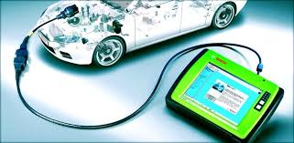
VEHICLE MAINTENACE AND REPAIR
Chapter 13 Inspection and Service auto electric system service
Introduction to On-Board Diagnostics (OBD)
How the System Works
The Diagnostic Ecosystem
An interconnected network of hardware, software, data resources, and services that work together to identify diseases or monitor health conditions of vehicle
Sensors: Gather data (e.g., oxygen levels, engine temperature, wheel speed). Vehicle performance in real time.
ECUs: Computer brains process sensor data. Analyzing sensor data for error
DTCs: Fault codes generated when data falls outside safe limits.
MIL: The dashboard "Check Engine" light turns on to alert the driver.
If a sensor reads something abnormal, it tells the computer. The computer logs a specific code and turns on the dashboard light.
By Ibrahim siraj
Maldives polytechnic

Slide 21
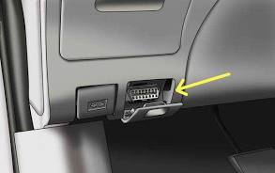
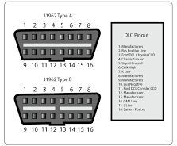
VEHICLE MAINTENACE AND REPAIR
Chapter 13 Inspection and Service auto electric system service
Introduction to On-Board Diagnostics (OBD)
🔌 The OBD-II Port
Location: Usually under the dashboard on the driver's side.
Standard: Mandatory on all US cars built since 1996.
Shape: A distinctive 16-pin trapezoidal connector.
By Ibrahim siraj
Maldives polytechnic

Slide 22
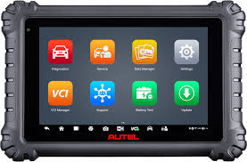
VEHICLE MAINTENACE AND REPAIR
Chapter 13 Inspection and Service auto electric system service
Introduction to On-Board Diagnostics (OBD)
Continuous Monitoring: Internal Electronic Control Units (ECUs) read data from various sensors spread across the engine, transmission, and braking systems.
Fault Detection: If a sensor detects an operational metric outside acceptable limits, the system logs a Diagnostic Trouble Code (DTC).
Driver Notification: The system illuminates the Malfunction Indicator Light (MIL)—commonly known as the "Check Engine" light—on your dashboard.
Data Access: Mechanics or vehicle owners can plug an external scan tool into the physical 16-pin Diagnostic Link Connector (DLC) to read the fault codes and live data parameters.
By Ibrahim siraj
Maldives polytechnic

Slide 23
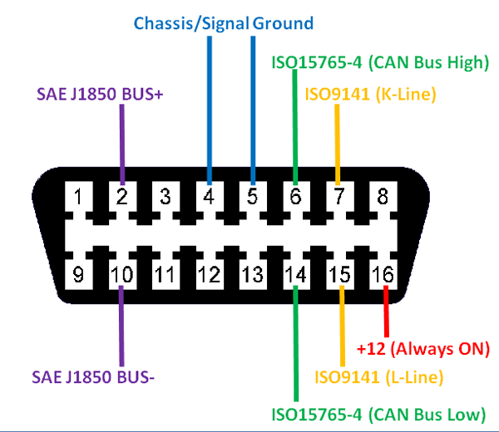
VEHICLE MAINTENACE AND REPAIR
Chapter 13 Inspection and Service auto electric system service
Introduction to On-Board Diagnostics (OBD)
The Physical Connection (DLC)
The Diagnostic Link Connector
The Interface: A standardized 16-pin trapezoidal connector plug.
Location: Always located within 3 feet of the driver’s steering wheel (usually under the dashboard).
Pins: Separate pins are dedicated to battery power, grounding, and high-speed data communication lines.
By Ibrahim siraj
Maldives polytechnic

Slide 24
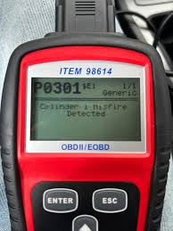
VEHICLE MAINTENACE AND REPAIR
Chapter 13 Inspection and Service auto electric system service
Introduction to On-Board Diagnostics (OBD)
Decoding Diagnostic Trouble Codes (DTCs)
How to Read a Fault Code
Structure: Standard codes use 5 alphanumeric characters (e.g., P0300).
First Letter (System): P = Powertrain (Engine/Trans), B = Body, C = Chassis, U = Network.
Second Digit (Type): 0 = Standard Generic Code, 1 = Manufacturer Specific Code.
Third Digit (Sub-system): 3 = Engine Misfire, 7 = Transmission, etc.
Last Two Digits: Specific fault description identifier
P0300 is a classic example. "P" means it's an engine issue, "0" means it's a generic code any scanner can read, and "3" means there is a cylinder misfire
By Ibrahim siraj
Maldives polytechnic

Slide 25
THANK YOU

